Slide 1
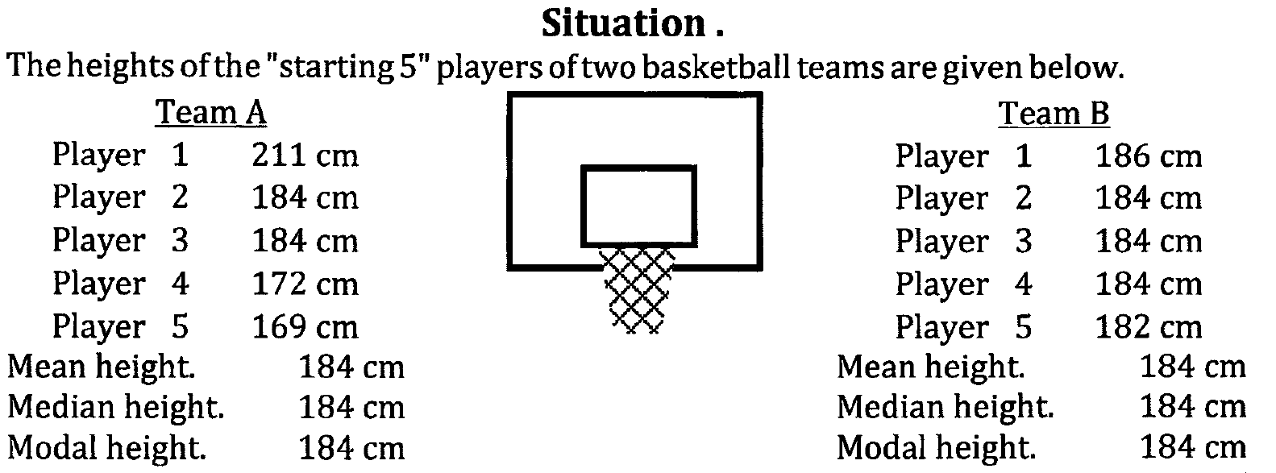
Measures of Spread
Given that the two teams of 5 players have the same mean, median and mode height as each other, you would think their heights would be fairly similar. However, just looking at measures of centre (mean and median) doesn’t show the whole picture.
We can use the range as a measure of spread (how spread out the data is).
Team A has a range of 211 – 169 = 42 cm.
Team B has a range of 186 – 182 = 4 cm.
So we can say that the heights of team A are more spread out and less consistent than the heights of team B.

Slide 2
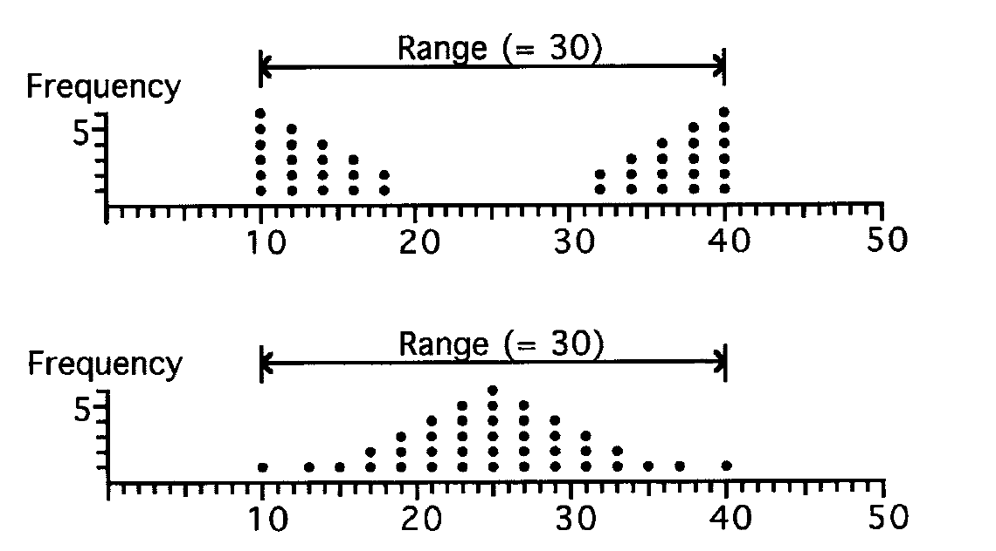
Measures of Spread
However, range isn’t always very useful as a measure of spread because it only takes into account the lowest and highest value. These two dot frequency diagrams have the same range but their spread is very different.
We need to consider other measures of spread.

Slide 3
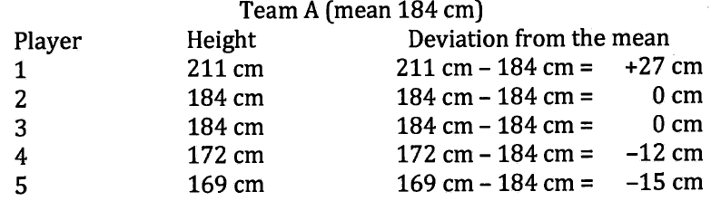
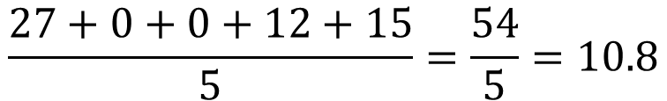
Mean Deviation
The mean deviation is the average of deviations from the mean (the difference between each value in the data set and the mean).
Player 1’s deviation from the mean is their height subtract the mean height: 211 – 184 = 27
We ignore the negative signs (else we get a sum of 0) and find the mean of the 5 deviations.
The lower the mean deviation is, the less spread out the data is. The higher the mean deviation is, the more spread out the data is.
$$\frac{27+0+0+12+15}{5}=\frac{54}{5}=10.8$$

Slide 4
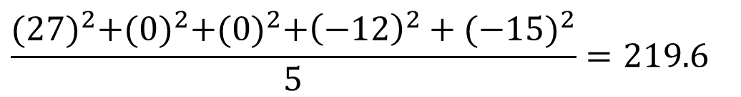
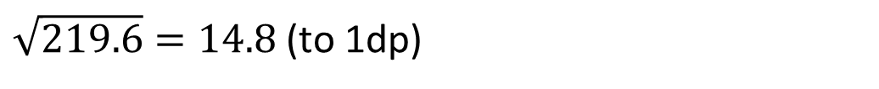
Standard Deviation
Finding the standard deviation is a more complicated process (and you do need to know how to do it by hand). Standard deviation is a commonly used measure of dispersion (spread) in data analysis.
1. Square the deviations.
2. Find the mean of the squared deviations (this is known as the variance).
3. Square root the variance to get the standard deviation.
$$\frac{{(27)}^{2}+{(0)}^{2}+{(0)}^{2}+{\left(−12\right)}^{2}+{(−15)}^{2}}{5}=219.6$$
The lower the standard deviation is, the less spread out the data is. The higher the standard deviation is, the more spread out the data is.
$\sqrt{219.6}=14.8$(to 1dp)
The variance is 219.6 and the standard deviation is 14.8.

Slide 5
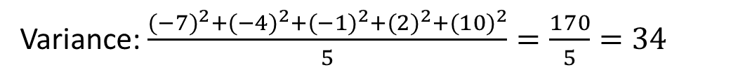
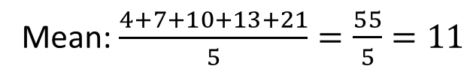
Example 1
Now do Exercise 3A
Find the mean, the variance and the standard deviation of the set of scores:
4, 7, 10, 13, 21
Standard Deviation:
1. Square the deviations.
2. Find the mean of the squared deviations (this is known as the variance).
3. Square root the variance to get the standard deviation.
Mean: $\frac{4+7+10+13+21}{5}=\frac{55}{5}=11$
Variance: $\frac{{(−7)}^{2}+{(−4)}^{2}+{(−1)}^{2}+{(2)}^{2}+{(10)}^{2}}{5}=\frac{170}{5}=34$
Standard Deviation: $\sqrt{34}=5.83$(to 2dp)
The scores have a mean of 11, a variance of 34 and a standard deviation of 5.83.

